Slide 1
Professor
Jorge Alfonso Meléndez Acuña

Slide 2

Types of graphs and terms

Slide 3
Undirected graph
Directed
graph
1
2
1
2
0
5
0
5
3
4
3
4

Slide 4
Undirected graph
1
2
An undirected graph is a graph where edges do not have a particular direction.
0
5
3
4

Slide 5













Undirected graph
Example: friendship on Facebook
An undirected graph is a graph where edges do not have a particular direction.

Slide 6
Undirected graph
Example: friendship on Facebook
An undirected graph is a graph where edges do not have a particular direction.
g is friend with b and b is friend with g the relationship goes both ways.

Slide 7
Directed graph
1
2
A directed graph is a graph where edges have a particular direction.
0
5
3
4

Slide 8
Directed graph
tail
head
1
2
A directed graph is a graph where edges have a particular direction.
0
5
3
4

Slide 9
Directed graph
Example: following on X (Twitter)
A directed graph is a graph where edges have a particular direction.

Slide 10
Directed graph
Example: following on X (Twitter)
A directed graph is a graph where edges have a particular direction.
g follows b but not the opposite.

Slide 11
Unweighted
graph
Weighted
graph
1
2
1
2
8
45
0
5
0
31
25
5
18
22
11
29
3
4
3
4

Slide 12













324
285
88
133
223
166
186
312
267
426
252
75
288
412
328
121
267
296
475
210

Slide 13
324
285
88
133
223
166
186
312
267
426
252
75
288
412
328
121
267
296
475
210

Slide 14
324
285
133
223
its weight
88
166
186
312
267
426
426
252
75
288
edge
412
328
121
267
296
475
210

Slide 15
Weighted graph
1
2
8
A weighted graph is a graph where we associate a weight to each edge, it can represent a cost, a distance, a speed limit, ...
45
25
0
31
5
18
22
11
29
3
4

Slide 16
Unweighted graph
1
2
A weighted graph is a graph where we do not associate weights to edges.
0
5
3
4

Slide 17
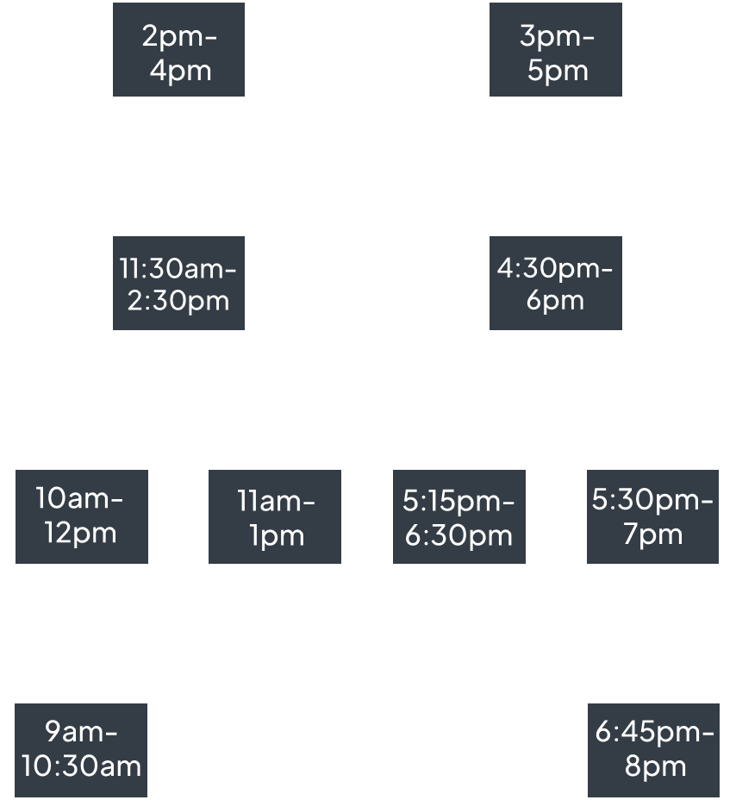
Unweighted graph
A weighted graph is a graph where we do not associate weights to edges.
Example: overlapping car rides

Slide 18
Degree
(3)
(4)
(1)
A
B
C
The degree of a vertex 𝑣 is the number of edges the vertex is incident to, denoted deg⁡(𝑣).
(2)
(3)
(2)
D
E
F
(2)
(1)
(0)
G
H
I

Slide 19
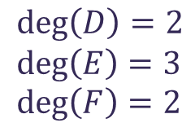
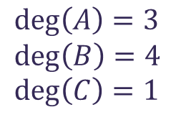
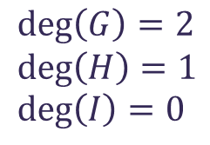
Degree
(3)
(4)
(1)
A
B
C
The degree of a vertex 𝑣 is the number of edges the vertex is incident to, denoted deg⁡(𝑣).
(2)
(3)
(2)
D
E
F
$$\deg\left(A\right)=3 \\ \deg\left(B\right)=4 \\ \deg\left(C\right)=1$$
$$\deg\left(D\right)=2 \\ \deg\left(E\right)=3 \\ \deg\left(F\right)=2$$
$$\deg\left(G\right)=2 \\ \deg\left(H\right)=1 \\ \deg\left(I\right)=0$$
(2)
(1)
(0)
G
H
I

Slide 20
The edge is going out of A and going in B.
A
B

Slide 21
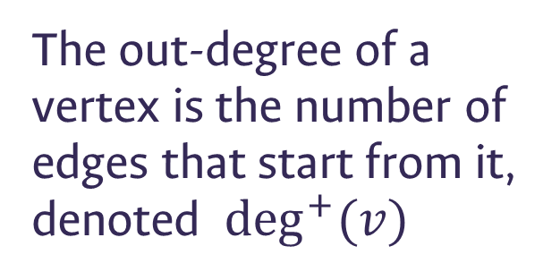
Out-degree
The out-degree of a vertex is the number of edges that start from it, denoted $\deg^{+}{(v)}$

Slide 22
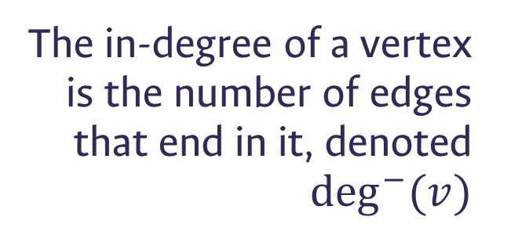
Out-degree
In-degree
The out-degree of a vertex is the number of edges that start from it, denoted $\deg^{+}{(v)}$
The in-degree of a vertex is the number of edges that end in it, denoted $\deg^{−}{(v)}$

Slide 23
Out-degree
In-degree
The out-degree of a vertex is the number of edges that start from it, denoted $\deg^{+}{(v)}$
The in-degree of a vertex is the number of edges that end in it, denoted $\deg^{−}{(v)}$
$$\deg\left(v\right)=\deg^{+}{(v)}+\deg^{−}{(v)}$$

Slide 24
24
A
B
C
B has 3 edges going out of it, so its out-degree is 3. It has 1 edge going in it, so its in-degree is 1. Its total degree is 4 (3+1).
D
E
F
G
H
I

Slide 25
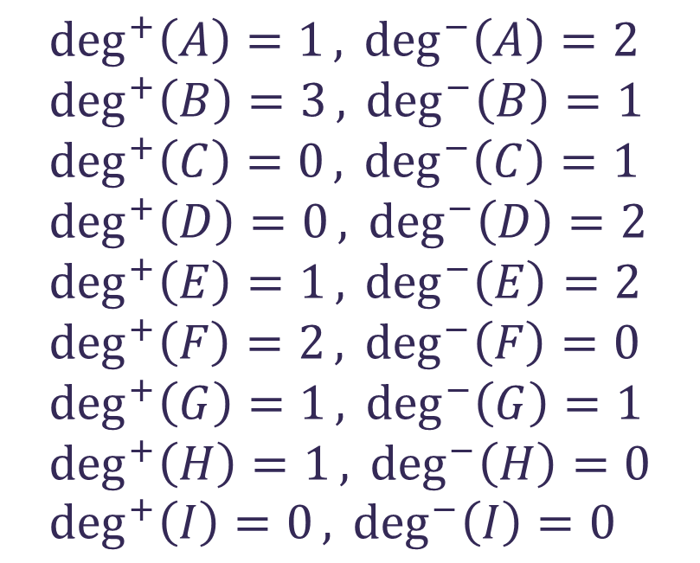
out-degree
in-degree
$$\deg^{+}\left(A\right)=1,\deg^{−}\left(A\right)=2 \\ \deg^{+}\left(B\right)=3,\deg^{−}\left(B\right)=1 \\ \deg^{+}\left(C\right)=0,\deg^{−}\left(C\right)=1 \\ \deg^{+}\left(D\right)=0,\deg^{−}\left(D\right)=2 \\ \deg^{+}\left(E\right)=1,\deg^{−}\left(E\right)=2 \\ \deg^{+}\left(F\right)=2,\deg^{−}\left(F\right)=0 \\ \deg^{+}\left(G\right)=1,\deg^{−}\left(G\right)=1 \\ \deg^{+}\left(H\right)=1,\deg^{−}\left(H\right)=0 \\ \deg^{+}\left(I\right)=0,\deg^{−}\left(I\right)=0$$
(1)(2)
(3)(1)
(0)(1)
A
B
C
(0)(2)
(1)(2)
(2)(0)
D
E
F
(1)(1)
(1)(0)
(0)(0)
G
H
I

Slide 26
Order
The order of a graph is its number of vertices: |𝑉|
Size
The size of a graph is its number of edges: |𝐸|

Slide 27
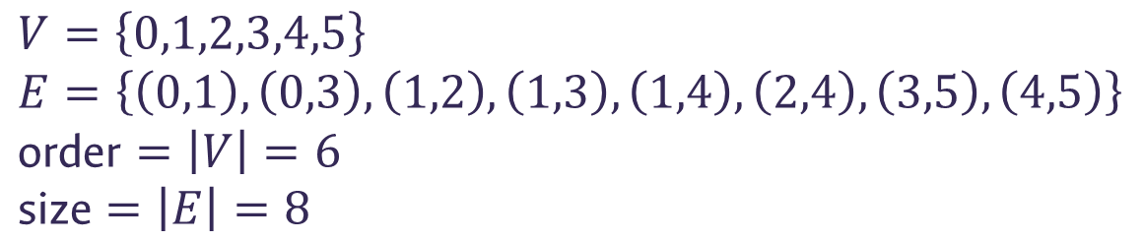
Order
1
2
The order of a graph is its number of vertices: |𝑉|
0
5
Size
The size of a graph is its number of edges: |𝐸|
3
4
$$V=\left\{0,1,2,3,4,5\right\} \\ E=\left\{\left(0,1\right),\left(0,3\right),\left(1,2\right),\left(1,3\right),\left(1,4\right),\left(2,4\right),\left(3,5\right),\left(4,5\right)\right\} \\ \text{order}=\left|V\right|=6 \\ \text{size}=\left|E\right|=8$$

Slide 28
Simple graph
Multigraph
Simple graphs are graphs that allow neither multiple edges between the same two vertices nor self-loops.
Multigraphs are graphs that allow multiple edges between the same two vertices, and for self-loops, some authors say that they are allowed and some others say that they are not.
1
2
1
2
0
5
0
5
3
4
3
4

Slide 29

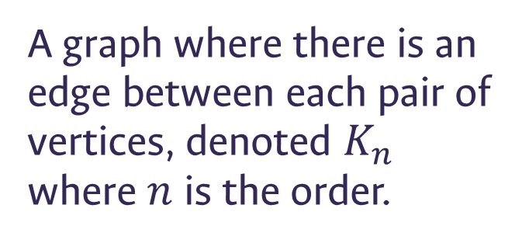
Complete graph
Example: $K_{5}$
0
A graph where there is an edge between each pair of vertices, denoted $K_{n}$ where $n$ is the order.
1
2
3
4

Slide 30
Star graph
Example:
0
A graph where we have 1 vertex of degree 𝑛−1 and 𝑛−1 vertices of degree 1.
1
2
5
3
4

Slide 31
Bipartite graph
Example:
0
A graph whose set of vertices can be partitioned into two sets of vertices such that there is no edge between two vertices of the same subset.
6
2
3
4
5
1

Slide 32


Bipartite graph
Example:
$$V_{1}$$
$$V_{2}$$
0
A graph whose set of vertices can be partitioned into two sets of vertices such that there is no edge between two vertices of the same subset.
6
2
3
4
5
1

Slide 33


Bipartite graph
$$V_{1}$$
Example:
$$V_{2}$$
0
A graph whose set of vertices can be partitioned into two sets of vertices such that there is no edge between two vertices of the same subset.
6
2
3
4
5
1

Slide 34

Bipartite graph
$$V_{1}$$
Example:
$$V_{2}$$
0
A graph whose set of vertices can be partitioned into two sets of vertices such that there is no edge between two vertices of the same subset.
6
2
3
4
5
1

Slide 35



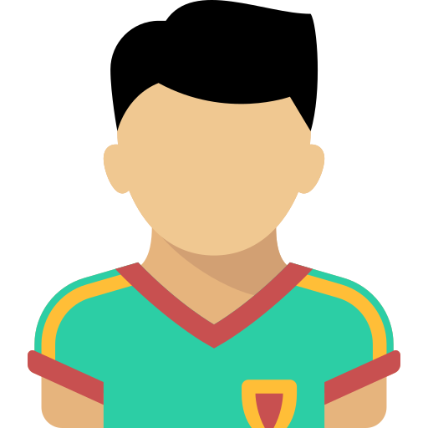





played in

Slide 36
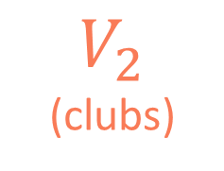
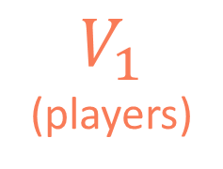
$V_{1}$
(players)
played in
$V_{2}$
(clubs)

Slide 37



Complete bipartite graph
Example: $K_{4,3}$
$$V_{1}$$
$$V_{2}$$
0
A bipartite graph where there is an edge between each vertex of 𝑉_1 and each vertex of 𝑉_2, denoted 𝐾_(𝑚,𝑛) where.
𝑚=|𝑉_1 | and 𝑛=|𝑉_2 |
6
2
3
4
5
1

Slide 38

Regular graph
Example: $∀v∈V \deg\left(v\right)=2$
(2)
(2)
0
1
A graph whose vertices have the same degree.
(2)
(2)
2
3

Slide 39
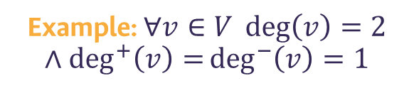
Regular graph
Example: $∀v∈V \deg\left(v\right)=2$
$$∧\deg^{+}\left(v\right)=\deg^{−}\left(v\right)=1$$
(1)(1)
(1)(1)
A graph whose vertices have the same degree.
For directed graphs, each vertex must also satisfy the condition deg^+⁡〖(𝑣)=〗 deg^−⁡〖(𝑣)〗
0
1
(1)(1)
(1)(1)
2
3

Slide 40
Sparse graph
A graph whose the number of edges is way smaller than the possible number of edges.
1
2
0
5
3
4

Slide 41
Sparse graph
Dense graph
A graph whose the number of edges is way smaller than the possible number of edges.
A graph whose the number of edges is close to the possible number of edges.
1
2
1
2
0
5
0
5
3
4
3
4

Slide 42
Paths and cycles
C
D
E
B
F
A
G
L
H
K
J
I

Slide 43

Path
C
D
E
B
F
A path is a walk that allows neither repeated edges nor repeated vertices.
A
G
L
H
K
J
I
Example:$A→B→L→E→H$
Valid path because it has neither repeated edges nor repeated vertices.

Slide 44

Path
C
D
E
B
F
A path is a walk that allows neither repeated edges nor repeated vertices.
A
G
L
H
K
J
I
Example: $A→B→K→J→D→C→J→D→E→H$
Invalid path because it has repeated edges and repeated vertices

Slide 45
Cycle
C
D
E
B
F
A cycle is a closed path, a path whose first and last vertex are equal.
A
G
L
H
K
J
I
Example:$A→B→L→E→H→G→A$

Slide 46
D
C
E
B

Slide 47

D
C
E
B
D
C
E
B

Slide 48
Connected
C
D
E
A graph 𝐺=(𝑉,𝐸) is connected if ∀ 𝑢,𝑣∈𝑉 there exists a path between 𝑢 and 𝑣.
B
F
A
G
L
H
Example: There exists a path between each pair of vertices in this graph.
K
J
I

Slide 49
Disonnected
C
D
E
A graph 𝐺=(𝑉,𝐸) is disconneted if ∃ 𝑢,𝑣∈𝑉 such that there is no path between 𝑢 and 𝑣.
B
F
A
G
L
H
Example: There is no path between A and E, so the graph is disconnected.
K
J
I

Slide 50
Types and terms

Slide 51
Good bye

Slide 53
Credits
Subject Matter Expert
Instructional Designer
Jorge Alfonso Meléndez Acuña
Angela Maria Arboleda Restrepo
Subject Matter Expert
Graphic Designer
Luis Fernando Niño Vásquez
Tania Valentina Flórez Rincón
First version
Date: April 2025

